Slide 1
Laptop Price Analysis
Data Driven Decision Making
Louis Ampobi

Slide 2
Introduction & Background
Here is the thing. I have had to buy two different laptops during the course of this bootcamp. So I thought to myself.
In this presentation the objective is to make data driven decision making in acquiring a new laptop.
The goal is to analyze and correlate the price of laptops based on various features such as company, type, size, screen resolution, CPU, RAM, storage, GPU, operating system, and weight. This can help in understanding the key factors that influence laptop pricing and assist in making informed decisions for both me a consumer, but also businesses.

Slide 3
Data Overview
This consisted of two datasets, that were merged during data wrangling into one. The new dataset contains information about various laptop models with the following fields:
Company: The manufacturer of the laptop.
TypeName: Type of laptop (e.g., Ultrabook, Notebook).
Inches: Screen size in inches.
Screen Resolution: Screen resolution details.
Cpu: Details of the CPU.
Ram: Amount of RAM in GB.
Memory: Storage capacity and type.
Gpu: Details of the GPU.
OpSys: Operating system.
Weight: Weight of the laptop.
Price: Price of the laptop.

Slide 4
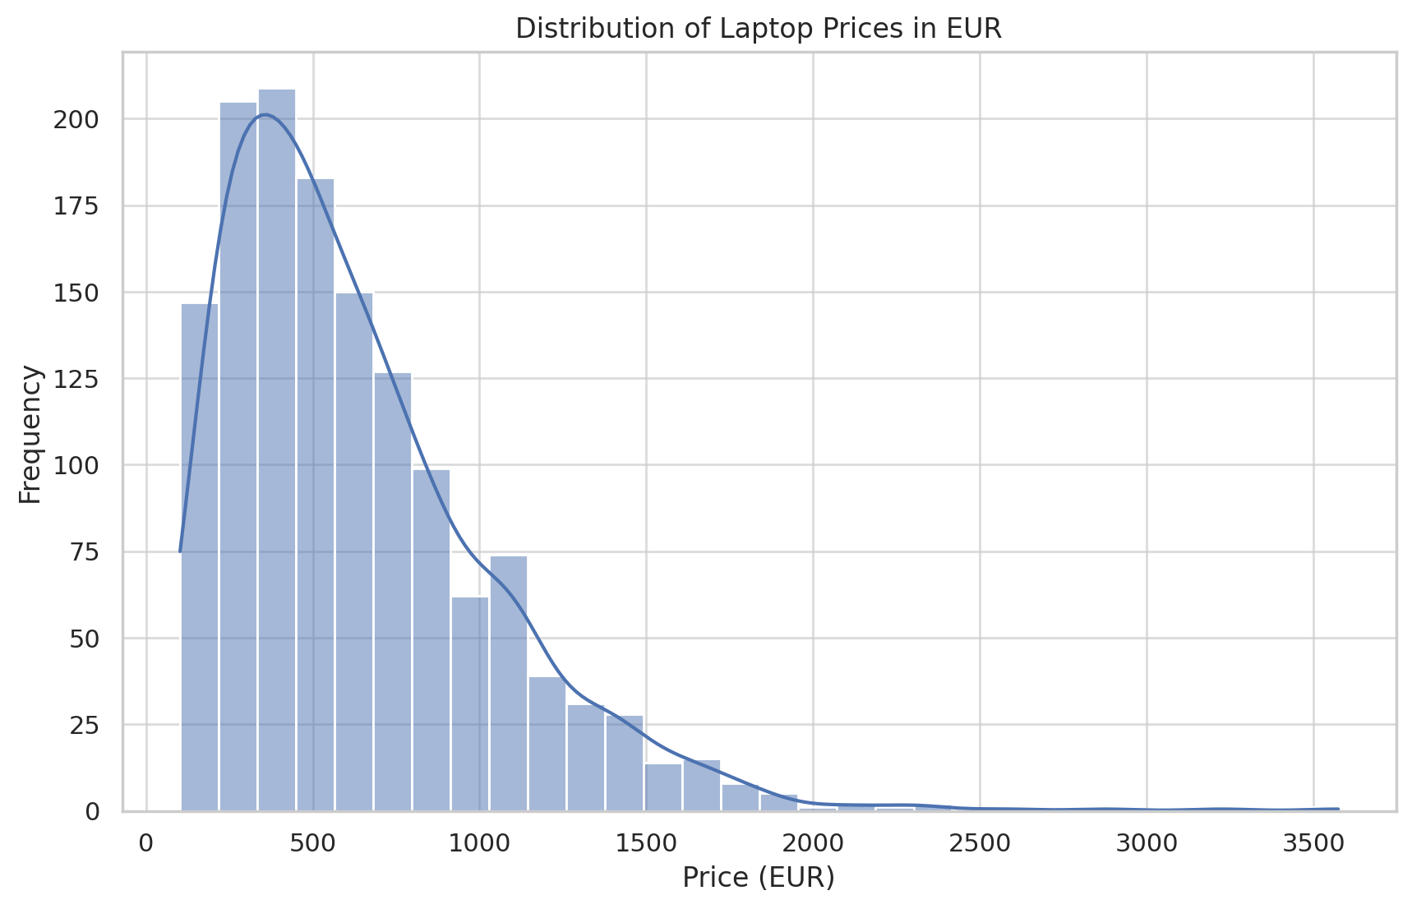
Exploratory Data Analysis: Features and Price
The distribution of laptop prices shows a right-skewed distribution, indicating that most laptops are priced towards the lower end, with fewer laptops in the higher price ranges.

Slide 5
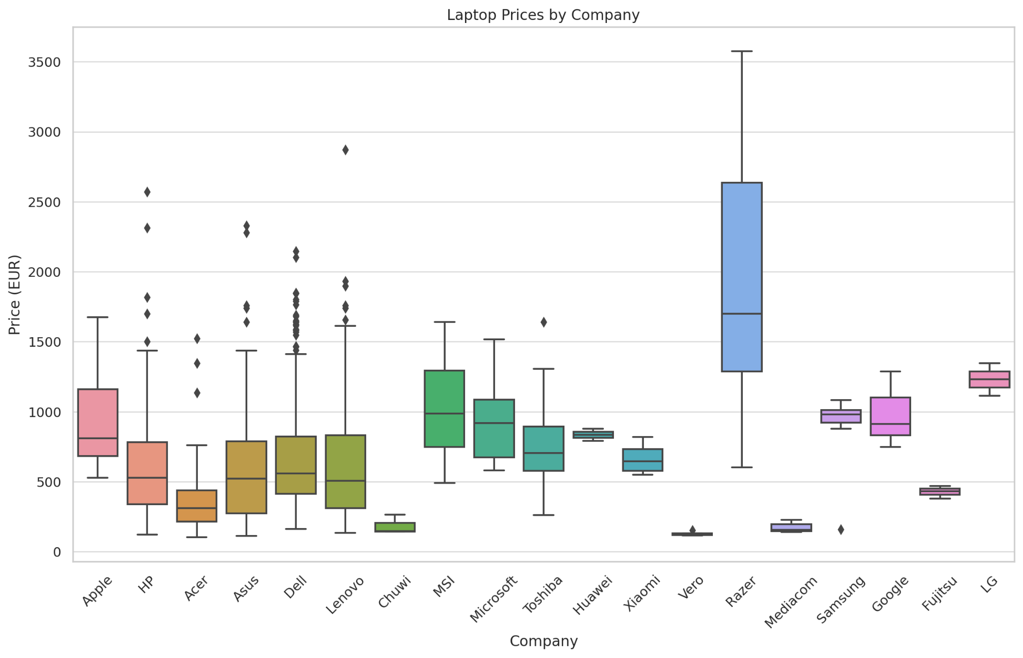
Exploratory Data Analysis: Features and Price
The boxplot shows the distribution of laptop prices across different companies. We can observe that Razer has the highest median price with significant variation. Chuwi and Vero have the lowest prices. Apple, HP, Dell, and Lenovo show moderate to high median prices with various degrees of price dispersion.

Slide 6
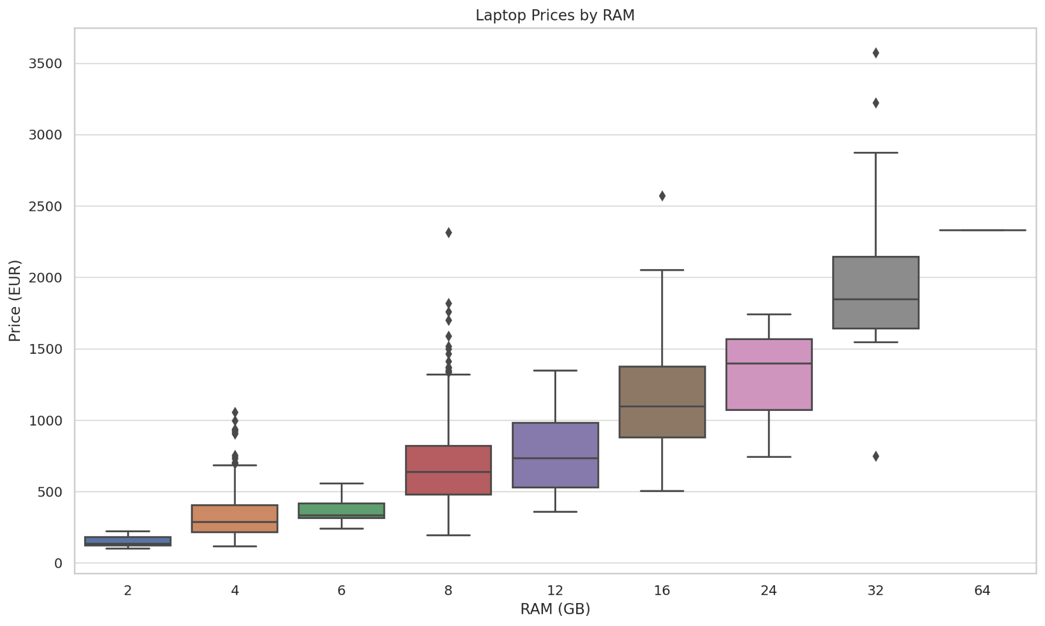
Exploratory Data Analysis: Features and Price
As the RAM increases, the median price also tends to increase.
Laptops with 64GB RAM have the highest median price.
There is a noticeable price increment trend from 2GB to 32GB RAM.
8GB and 16GB RAM laptops show a wide range of prices with several outliers.

Slide 7
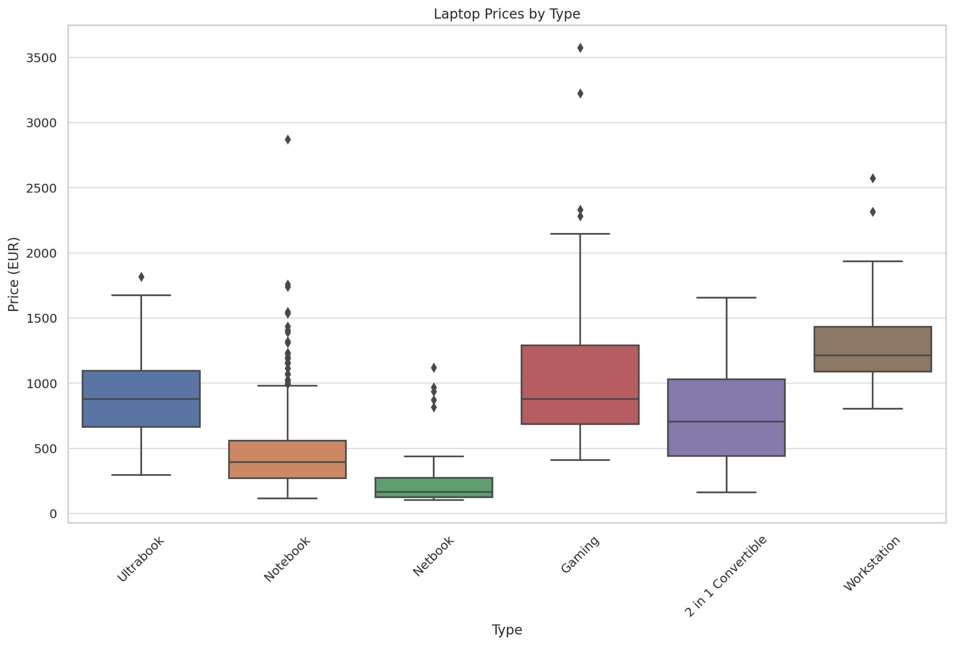
Exploratory Data Analysis: Features and Price
Gaming laptops have the highest median price among the different types, with a broad price range for normal laptops.
Netbooks are the least expensive, with the lowest median price.
Ultrabooks and Workstations have moderate to high median prices with considerable variation.
Notebooks and 2 in 1 Convertible laptops are in the mid-range in terms of pricing.

Slide 8
EDA Conclusion
Summary
By Company: Razer has the highest median prices, and Chuwi and Vero have the lowest.
By RAM: Higher RAM typically correlates with higher prices.
By Type: Gaming laptops are generally the most expensive, while netbooks are the least expensive.
Each box plot helps in understanding how prices vary based on different factors such as the company, RAM, and type, indicating trends and outliers in the laptop market.

Slide 9
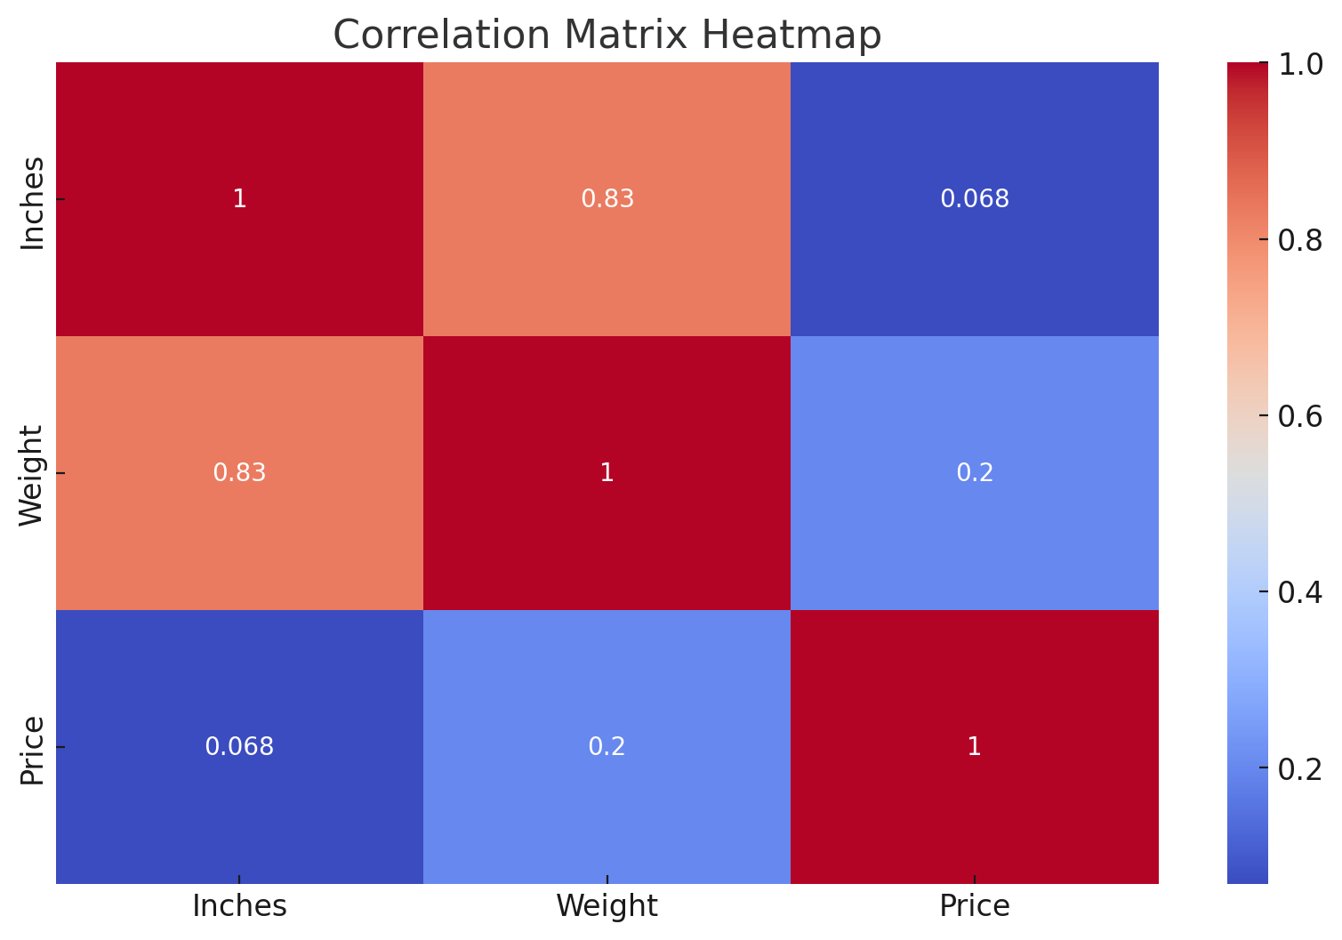
Correlation Analysis: Numerical Features

Slide 10
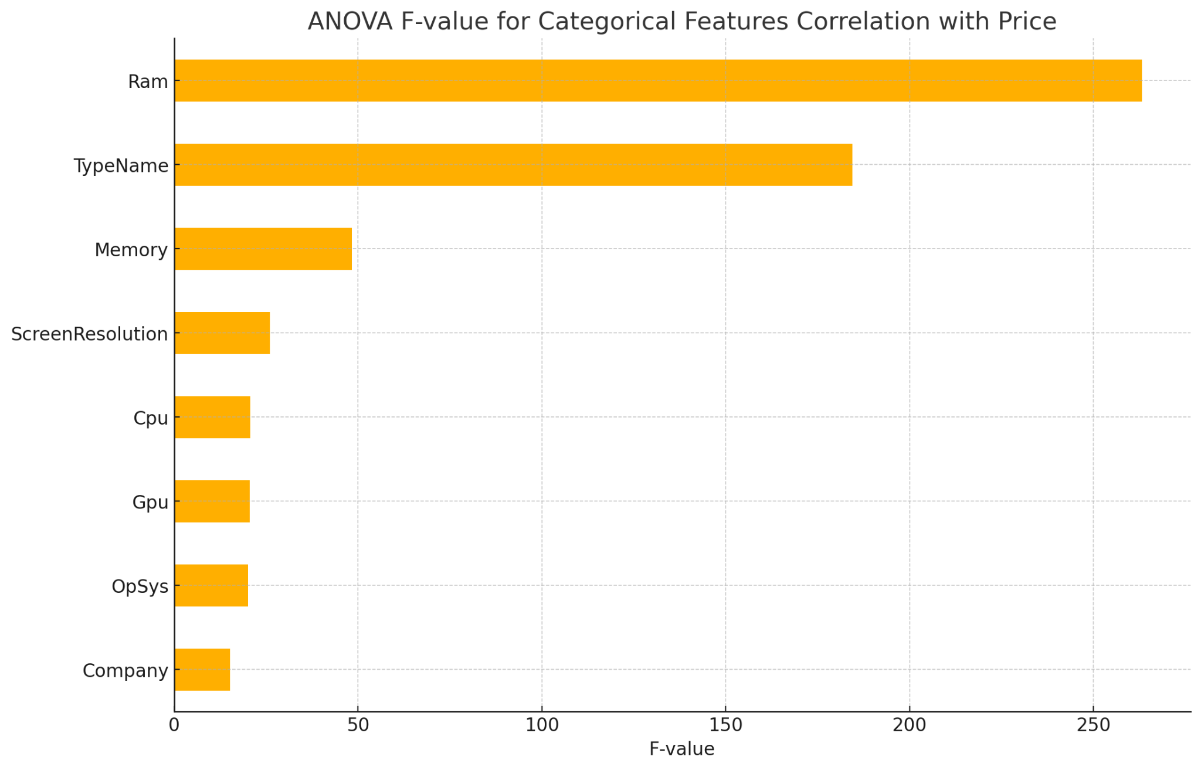
Correlation Analysis: Numerical Features(Anova)
Key Findings:
TypeName and Ram are the most influential categorical features affecting the price.
Company and Cpu also show significant correlation with price.
Screen Resolution and Gpu have moderate influence.
Inches and Weight have a more modest correlation with price.

Slide 11
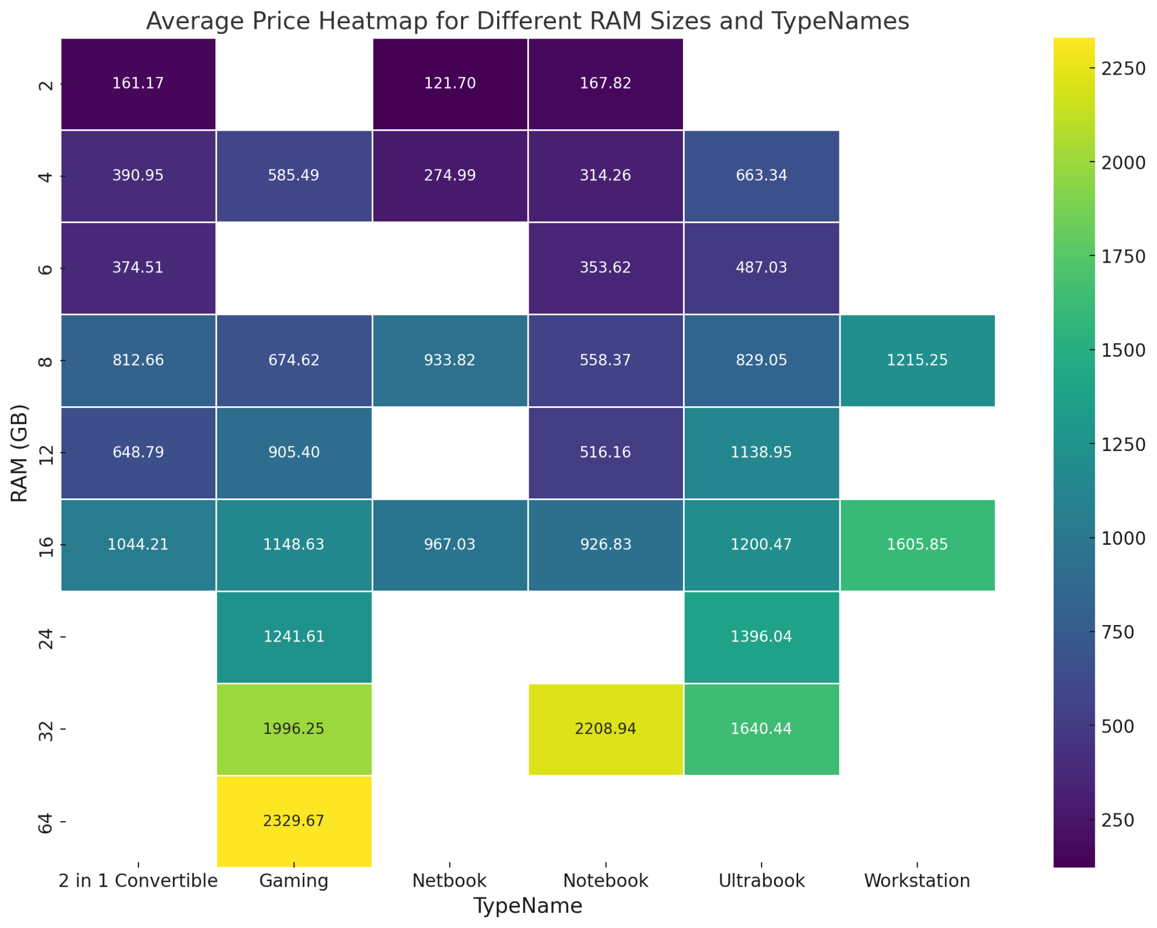
Correlation HeatMap: Ram/Type Name by price

Slide 12
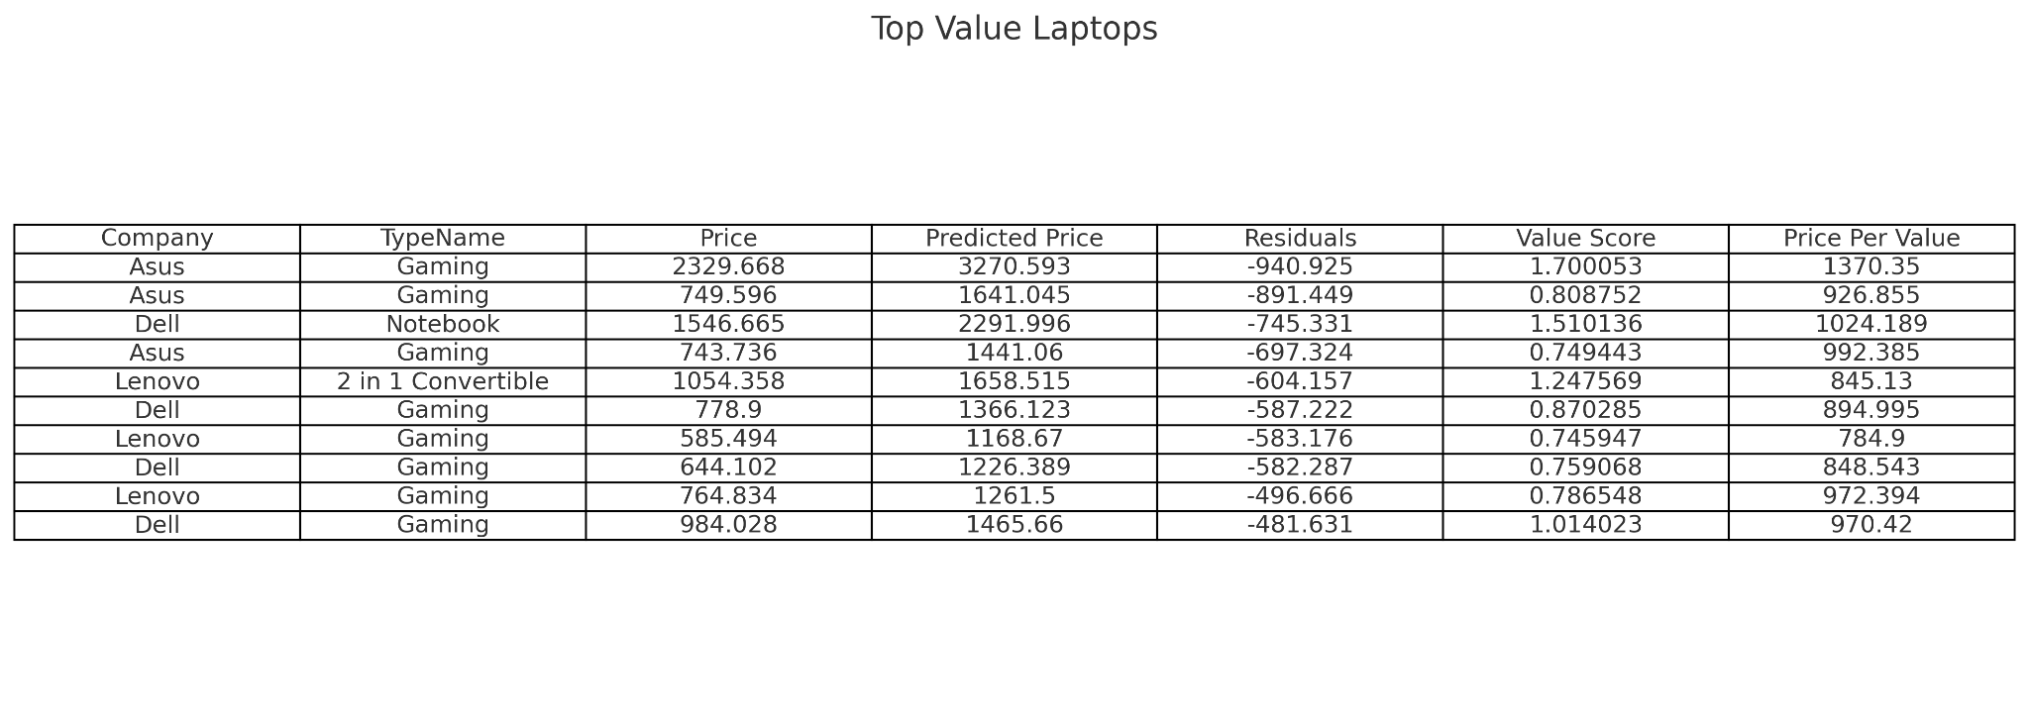
Linear Regression and Residual Analysis
The regression analysis provides predicted prices and residuals for each laptop. Here's how to interpret these results:
Predicted Price: The price predicted by the regression model based on the selected features.
Residuals: The difference between the actual price and the predicted price. Positive residuals indicate that the laptop is more expensive than predicted, while negative residuals indicate that the laptop is cheaper than predicted.

Slide 13
Insights And Conclusion
Insights
Asus Gaming Laptops: Asus gaming laptops are prominently featured, suggesting they offer significant value for money, with prices significantly lower than predicted.
Dell and Lenovo Gaming Laptops: These brands also provide good value, particularly for gaming models, which are underpriced relative to their features.
2 in 1 Convertible: Lenovo's 2 in 1 convertible is also an excellent value option, providing flexibility and performance at a lower price than predicted.
Recommendations
Best Brands: Asus, Dell, and Lenovo are top brands offering value for money in gaming and notebook categories.
Optimal Purchase: Customers seeking the best specs for their spend should consider gaming laptops from Asus and Dell, as well as convertible models from Lenovo.
This analysis provides a comprehensive view of the best value laptops. If further machine learning analysis is needed, we could consider clustering or advanced predictive modeling, but the current approach offers clear and actionable insights. ​

Slide 14
Challenges
Dataset had limited information. I would have loved to do geographical Analysis as well but it I could not find a good dataset to that effect.
Know how needed for implementation of machine learning model to predict price at the expected tin of purchase if there were time features available for analysis.

Slide 15
Thank you!

